Slide 1

Understanding a Site’s Traffic With Google Analytics
Understanding google analytics
Daniel Stern
code whisperer
@danieljackstern

Slide 2

Understanding Google Analytics
Understanding how it works and when to use it is the first step to successfully implementing Google Analytics.

Slide 3
Course Roadmap

Slide 4

Understanding Google Analytics
Advantages and business application
Adding Google Analytics to a Site
Explain and implement necessary JavaScript code
Google Analytics Campaigns
Drive traffic from multiple sources to our site and measure it
Google Analytics Reports
Investigate data organized in a variety of different ways

Slide 5
A Typical Workplace Scenario

Slide 6
“Both sides are even; Here I’ll sit in the midst.”
William Shakespeare, Macbeth

Slide 7

You have been selected you from hundreds of applicants as the new Digital Marketing Specialist for Bethany’s Pie Shop.
Bethany provides you with only a limited budget with which to pay for search keywords, email campaigns, influencer sponsorships and direct mail.
You will need to maximize the results of all these efforts to generate the most business for Bethany with your limited budget.
Where do you start?

Slide 8



Why Use Google Analytics?
Identify the sources which bring the best customers to a site
Understand and adapt to user demographics
Locate broken pages or catch script errors

Slide 9
Previewing the Google Analytics Dashboard

Slide 10
Overview of Google Analytics Features
Understand layout of dashboard
Explore features to be covered in upcoming modules

Slide 11
Is Google Analytics the Right Tool for the Job?

Slide 12

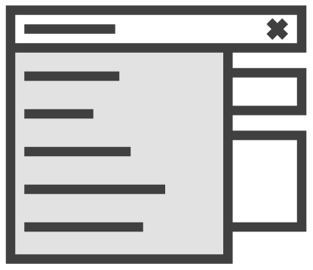

Google Analytics Key Features
Google Analytics has hundreds of features, but here are the ones that matter most for first time users.
Demographics
Reports
Campaigns
Know who and where your end users are
Gain insight by seeing the data presented in different ways
Track the origin of user traffic
Notes:
Version A of Key Features Slide

Slide 13



Relevant Google Analytics Features
The following features of Google Analytics are often highly relevant to business goals, and will be discussed in detail later in the course.
Simplicity
Campaigns
Reports
Adding Google Analytics to any site is simple with little setup required
Campaigns let you associate users with the source that brought them to your site
Reports break down data in different ways, revealing ways to maximize value
Notes:
Version B of Key Features Slide

Slide 14
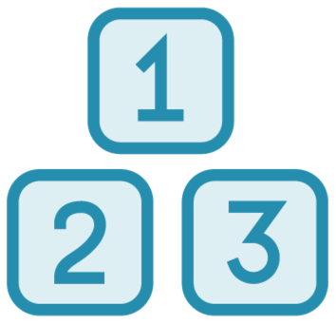
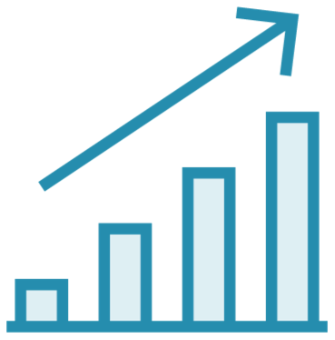

How is Google Analytics Used?
Collect data
Create campaigns
Explore reports
Recommend actions

Slide 15

Coming Up in the Next Module
Download and serve the demo application
Create Google Analytics Property
View Analytics data in real time

Slide 16
Adding Google Analytics to a Site
Daniel Stern
code whisperer
@danieljackstern

Slide 17
Google Analytics Workflow
The process for setting up Google Analytics on any website is very straightforward.
1
Create an analytics account and property
2
Use property ID from step 1 to add analytics to website
3
Start collecting analytics data automatically

Slide 18
Running the Demo Application

Slide 19
Review contents of demo app
Download demo app
Download available at http://danielstern.ca/analytics
The above link redirects
Run application locally
Deploy application to web
Recommended for collecting analytics
Options include Heroku, standard Apache-based hosting

Slide 20
Creating a Google Analytics Account

Slide 21
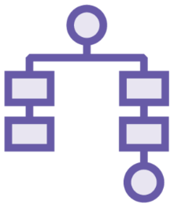


Why Create an Analytics Account?
You may find yourself managing multiple analytics campaigns for different clients or departments. How do you stay organized while delivering results?
Central place to analyze and organize data
Restrict analytics to authorized users
Reuse tools for multiple different clients

Slide 22



Before We Start
Creating an account is as simple as visiting Google Analytics while logged in to your Google Account.
Create a Google account (or log into existing one) http://mail.google.com
Visit Google Analytics https://analytics.google.com/
Follow prompts and agree to terms of use to create account

Slide 23
Create or log in to Gmail Account
Visit Google Analytics website
Prompts will automatically create GA account using Gmail
Account does not have any data until script is added to our site (later in this module)
Notes:
- Possible to replace demo with “Before Starting”

Slide 24
Creating a Google Analytics Property

Slide 25



What is a Google Analytics Property?
Properties are a means of grouping analytics events together by the site they apply to.
One property per site / app
Analytics for each property are separate
Properties can have different users and authorization

Slide 26
Create a new property
Property URL will match the URL to which we deployed the demo application
Note impact on Analytics
Property overview updated
Client ID provided (for use in next lecture)

Slide 27
Adding Google Analytics to the Site with JavaScript

Slide 28



How Does Adding Google Analytics to a Site Work?
Google has created and refined, over many years, an extremely simple process through which we can add Google Analytics to any site
Code snippet is inserted at the beginning of the app
Snippet loads full script which sends initial page view event to Google Analytics
Additional events are queued and sent to Google Analytics server

Slide 29
Understanding the JavaScript Code Used to Add Google Analytics to a Site

Slide 30
Two-Step Process for Adding Google Analytics to a Site
Use a code snippet to temporarily store any events sent out before analytics.js loads
Load analytics.js – queued events are sent to Google Analytics at this time, and future events are sent instantly

Slide 31
window.ga = window.ga || function() {
(ga.q = ga.q || []).push(arguments)
};
ga.l = +new Date;
ga(
`create`,
`UA-40501021-23`,
`auto`
);
ga(`send`, `pageview`);
Creates a dummy method called ga() in the global scope, which acts as a proxy until real script is loaded
The date and time are added to a property of the ga() method
This event which is being added to the queue create a tracker to send events to Google Analytics
This is where the unique ID for the property is specified
An initial pageview event is queued up – when analytics.js loads it will be sent to Google Analytics

Slide 32
Obtain code snippet from Google Analytics dashboard
Snippet is already personalized to our website
Paste snippet onto each page of the application
Snippet must go at the beginning
Redeploy application
Refer to Google Analytics dashboard and note instant results

Slide 33
Google Analytics must be added to each HTML page of a standard website
Google Analytics is added to a site via a simple JavaScript snippet
Script sends data to Google Analytics server
Data is aggregated in Google Analytics Dashboard
Summary

Slide 34
Coming Up in the Next Module
Understand Google Analytics Campaigns
Different traffic sources
UTM Tags
Create several “campaigns” to drive traffic to our site
Explore campaign interface on analytics dashboard

Slide 35
Implementing Google Analytics Campaigns
Daniel Stern
code whisperer
@danieljackstern

Slide 36

Spending Wisely
Your advertising budget includes ads in subway cars of five different cities. These ads are expensive. How can you know the ads are running without visiting those cities yourself? How can you determine if it’s worth the expense?

Slide 37
“O, that men’s ears should be “To counsel deaf, but not to flattery!”
William Shakespeare, Timon of Athens

Slide 38


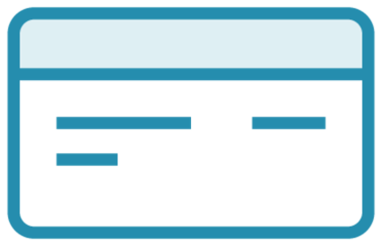

Why Use Google Analytics Campaigns?
Simple and cost effective
Measures traffic brought in by each source
Indicate which sources to invest more in
Alert analysts to broken links and missing print ads

Slide 39
Understanding How Google Analytics Campaigns Work

Slide 40
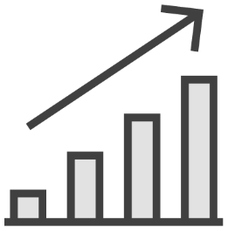


How Google Analytics Campaigns Work
Google Analytics Campaigns help us understand which marketing tools are working. But how?
Various efforts drive traffic to site (email, banner ads, paid sponsorships, etc.)
Unique URL assigned for each source of traffic using UTM tags
Analytics data is separated by source and best traffic sources are determined

Slide 41
Disassembling a Campaign URL
http://www.danielstern.ca?utm_campaign=boxing_week_21
Blue – The URL of the Website
Red – The text “utm_campaign” always appears on the left side of an equals sign with the campaign’s name on the right side.
Green – Unique campaign name

Slide 42
Understanding UTM Tags

Slide 43
Understanding UTM Tags
There are multiple kinds of UTM (Universal Tracking Module) tags, each with its own purpose. Here are some common ones.
BING GOOGLE TWITTER
SUMMER_SALE BOXING_WEEK ANNIVERSARY
FOOTER_LINK LOGO_LINK TEXT_LINK
utm_source
utm_campaign
utm_content
Used to identify the website or entity referring traffic
Name of the campaign, identifies a particular promotion
Refers to which linked is clicked within a given document

Slide 44
Determining ROI With Google Analytics

Slide 45
Determining ROI With Google Analytics
( # of Users from Campaign A * Percentage who purchased * Average Expenditure ) / ( # of Users from Campaign A * CPE for Campaign A )
= ROI of Campaign A
Track purchases (who and how much)
Determine source of user traffic (campaign)
Correlate cost of campaign to revenue from purchases
Notes:
Too technical? Needs special Math format?

Slide 46
Determining ROI With Google Analytics
Formula with Placeholders
Formula with Numbers
( # of Users from Campaign A * Percentage who purchased * Average expenditure ) / ( # of Users from Campaign A * CPE for Campaign A )
= ROI of Campaign A
( 10000 Users * 1% * $50 ) / ( 10000 Users * $.40 / User )
= 125%

Slide 47
Creating a Google Analytics Campaign

Slide 48

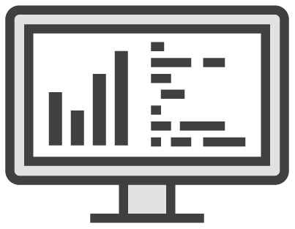
How to Create a Google Analytics Campaign
Campaigns created by adding utm_campaign=campaign_name to links to the site, or use URL tag builder
No special configuration for analytics account needed to create campaign

Slide 49
Use the Google Analytics tag builder to create a number of campaign URLs
https://ga-dev-tools.appspot.com/ campaign-url-builder/
Drive some traffic to the application using the campaign URLs
Examine campaign data on dashboard

Slide 50
Using Redirects to Create User Friendly Campaign URLs

Slide 51
Why use Redirects?
Hard to remember Easy to get wrong Not worth the trouble
Friendly Easy to remember
http://danielstern.ca/range.css/? utm_source=newsletter& utm_medium=email& utm_campaign=summer_sale
http://danielstern.ca/range.css/ summer-sale
bit.ly/abc123

Slide 52
Using Traditional Advertising in Conjunction with Campaigns
Campaigns are designed to aggregate user data for any sort of media campaign.
In this example, return on investment is measured for a message displayed on the side of a streetcar.
1
Create friendly URL for campaign: www.mysite.com/streetcar
2
Redirect friendly URL to a campaign URL: www.mysite.com? utm_campaign=streetcar
3
You can now view analytics just for this group.

Slide 53
A hit is a site traffic event.

Slide 54
What are Custom Hits?
Any user action, such as visiting the app, is called a hit
Custom hits, such as abandoning cart, can be easily created
Correlate hits with campaigns to measure results

Slide 55
Implementing Custom Hits on Our Site

Slide 56
Universal Tracking Module tags add many pieces of data to analytics
Referring website
Type of link clicked
Specific campaign or promotion
UTM tracking is accomplished by adding text to the end of a URL
Visiting dashboard not required
URL Builder tool good for beginners
UTM tags need to be added to the URL clicked or typed in by visitors
HTTP Redirects maintain friendly URL
Summary

Slide 57
Coming Up in the Next Module
Understanding Google Analytics reports
Review various report types available
Associate required data with applicable reports
Organize reports on dashboard
Explore custom reports

Slide 58
Realizing Actionable Insights with Google Analytics Reports
Daniel Stern
code whisperer
@danieljackstern

Slide 59
“Work with these, as bids thy reason, for they work thy toil to aid.”
John Sterling, The Husbandman

Slide 60
What are Google Analytics Reports?

Slide 61

There’s a Report For That
One sunny morning your boss races to the office to tell you they need to know what devices your customers are using to access the company website.
Tablets? Phones? PCs? Your boss needs to know in time for a meeting with the board of directors in just a few hours. What do you do?

Slide 62


What are Google Analytics Reports?
Each report is like a micro-dashboard which answers a particular category of questions.
Built in reports place different segments of data which are useful together in same place
Reports easily accessed, saved and shared
Various types of graphs – line, bar, geolocation (“geo”), etc.

Slide 63
A report is a page consisting of tables and charts sharing a common theme or purpose.

Slide 64
Exploring Reports

Slide 65
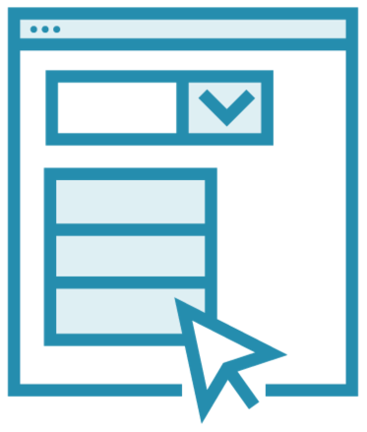
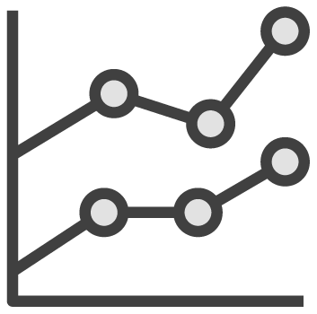
Accessing Google Analytics Reports
Default reports are automatically assembled and grouped in navigation pane
Clicking any report automatically brings up related details

Slide 66
Access several reports related to active website via reports menu
Audience
Acquisition
Behavior
Explore report interactivity
“Drill down” into demographic data

Slide 67
Understanding Events

Slide 68

Considering Events
Bethany’s has just added an exciting new feature to the website, a game where users bake as many pies as they can before time runs out.
Are users who score highly in this game more likely to make a purchase?
Unfortunately, “pies baked” is not an existing metric in Google Analytics. What to do?

Slide 69


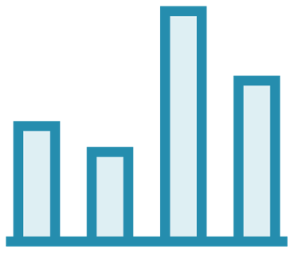
What Is an Event?
AJAX request sent to Google Analytics server from your site
Has a type, i.e., “pageview”, and metadata
Data from many events (hits) is aggregated into dashboard information

Slide 70
An event tells Google Analytics something unique to your site has occurred.

Slide 71



Why Use Events?
Events are an expert-level analytics tool used to realize more precise insights.
Programmatic
Custom
Specific
Events are added to the code base of the application by developers
Custom names and conditions let you track behavior unique to your application
Measure focus activity, cursor activity, form inputs and other metadata

Slide 72
Creating Custom Events

Slide 73
“The river of knowledge has no depth.”
― Chinonye Chidolue

Slide 74
Sending a Custom Event
gtag( 'event', 'search-focus' );
The self-contained code above sends a custom event called “search focus” to Google Analytics.
AJAX request is sent automatically.

Slide 75
Add HTML event that triggers whenever search bar is focused
Add handler for event which sends search-focus custom event to Analytics
Review incoming data in real-time dashboard

Slide 76
Creating Custom Reports

Slide 77
“The king hath happily received… the news of thy success.”
William Shakespeare, Macbeth

Slide 78



What are Custom Reports?
Custom reports are the solution when a client has a specific question to answer that is not available in the default report selection.
Advanced feature facilitating insights not available in default repots
Custom metrics and dimensions
Wide variety of community custom reports available

Slide 79


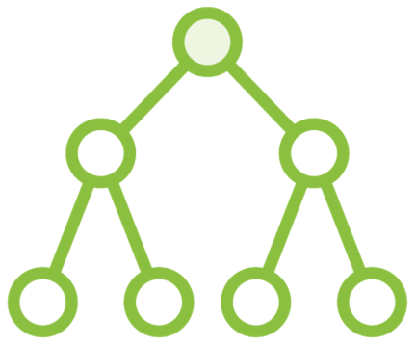
Features of Custom Reports
Custom reports are characterized by their ability to uniquely fit your project.
Dimensions
Metrics
Filters
Fields with unique values such as city, browser type or new versus returning visitor
Quantitative measurements such as number of visitors and pages per session
Modify repots by excluding or including segments
Notes:
https://support.google.com/analytics/answer/1033162?hl=en

Slide 80
Custom Report Examples

Slide 81




Custom Report Examples
SEO Insights for Organic Search
Sales by Day of the Week
404 Error Diagnostics and Reporting
Social Media Interactions
Notes:
Examples taken from Open Google Analytics Report Gallery

Slide 82
Creating a Custom Report

Slide 83
Create a new custom report
Custom Report creation form available on Analytics Dashboard
Explore different templates available
Select metrics and dimensions
Review data in custom report

Slide 84
Summary

Slide 85
Reports are the primary tool for analyzing data gathered by Google Analytics
Reports can provide insights into important business questions:
Where is traffic coming from?
Who and where are our users?
Which user behaviors indicate high likelihood to make a purchase?
Custom reports provide specific insights regarding whatever is needed for business goals
Summary

Slide 86
Using Reports to Analyze Campaigns

Slide 87
Dispatch a custom event whenever user focuses on search bar
Data automatically sent to Google Analytics
Interactions can be viewed in real time via Real-Time Events Report

Slide 88
Coming Up in the Next Module
Summarize most important ideas from each module
Enrichment activities
Guidance to continue improving and learning beyond this course

Slide 89
Conclusion
Daniel Stern
code whisperer
@danieljackstern

Slide 90
Google Analytics is used to learn more about who visits your site
In conjunction with the right actions, it can amplify the return on your advertising budget
JavaScript snippet placed on any HTML page to add analytics
AJAX request sent to Google every time user visits page
Metadata includes location, browser, bounce rate and more
Such data is called a “dimension”
Data can be grouped by these
Executive Summary

Slide 91
Campaigns can save money by optimizing advertising resources
UTM tags are used to group users by…
Referring website or newsletter
Unique promotion
Which call to action was clicked
Data appears organized on Google Analytics dashboard as a report
Reports combine interactive tables and charts
Custom reports can be created
Reports correlate various data points which results in actionable insights
Executive Summary

Slide 92
Enrichment Activities

Slide 93



Adding Google Analytics to a Real App
Choose a website you already own or manage. If you’re managing the app for someone else, get their permission to add GA before starting. If you have neither, create a simple blog with a few posts about nature, your cats, etc.
Add GA to Your App
Run a Campaign
Create a Report
Create a property and add the JavaScript tag to each HTML page or to the PHP Header
Send an email with links that have UTM tags to your mailing list, or post a promo to a relevant forum
Create a report that correlates metrics unique to your product. There are unlimited possibilities
Notes:
Makes sense to focus enrichment on extra-curricular apps?

Slide 94
“The names of the trees, of all the small animals, and all the birds, to know the language and have time be in it and to move slowly.”
Ernest Hemingway
Notes:
Green Hills of Africa

Slide 95
Thank You!

